Slide 1
Governance…
…is a messy business
Licensed under CC0 by paulofonseca.eth on #18691200

Slide 2
Politics…
…is a messy business
Licensed under CC0 by paulofonseca.eth on #18691200

Slide 3
Coordination…
…is a messy business
Licensed under CC0 by paulofonseca.eth on #18691200

Slide 4
Collaboration…
…is a messy business
Licensed under CC0 by paulofonseca.eth on #18691200
Licensed under CC0 by paulofonseca.eth on #18541392

Slide 5
Cooperation…
…is a messy business
Licensed under CC0 by paulofonseca.eth on #18691200

Slide 6
Governance…
…is a messy business
Licensed under CC0 by paulofonseca.eth on #18691200

Slide 7
Governance…
…is a messy, chaotic business
Licensed under CC0 by paulofonseca.eth on #18691200

Slide 8
Governance…
…is a messy, chaotic, sloppy business
Licensed under CC0 by paulofonseca.eth on #18691200

Slide 9
DAO Governance…
…is a messy, chaotic, sloppy business
Licensed under CC0 by paulofonseca.eth on #18691200

Slide 11
Who has joined a DAO?

Slide 12
Who has voted on an onchain DAO proposal?

Slide 13
Who has created and passed a DAO proposal?

Slide 14
Who has created a DAO governance system?

Slide 16
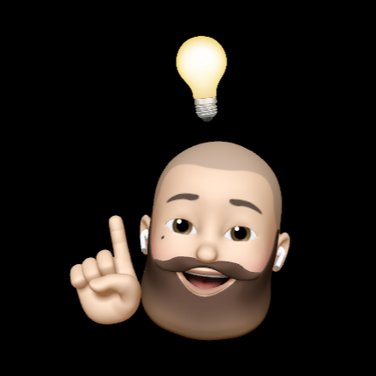
I’m Paulo Fonseca, I’ve been into DAOs since the infamous “The DAO” and I design tools for DAO people.
I also might have been involved in the birth and death of a DAO or two.
You can find out more about me at paulofonseca.com

Slide 17
DAO Governance
Licensed under CC0 by paulofonseca.eth on #18691200

Slide 18
Governance
Licensed under CC0 by paulofonseca.eth on #18691200

Slide 19
What is Governance, really?
…the structures, processes, and traditions that determine how:
power is exercised
stakeholders have their say
decisions are made
decision-makers are accountable
Licensed under CC0 by paulofonseca.eth on #18691200

Slide 20
What is Governance, really?
…the structures, processes, and traditions that determine how:
decisions are made
power is exercised
stakeholders have their say
decision-makers are accountable
Licensed under CC0 by paulofonseca.eth on #18691200

Slide 21
What is Governance, really?
…the structures, processes, and traditions that determine how:
power is exercised
stakeholders have their say
decisions are made
decision-makers are accountable
Licensed under CC0 by paulofonseca.eth on #18691200

Slide 22
What is Governance, really?
…the structures, processes, and traditions that determine how:
power is exercised
stakeholders have their say
decisions are made, by a group of people
decision-makers are accountable
Licensed under CC0 by paulofonseca.eth on #18691200

Slide 32
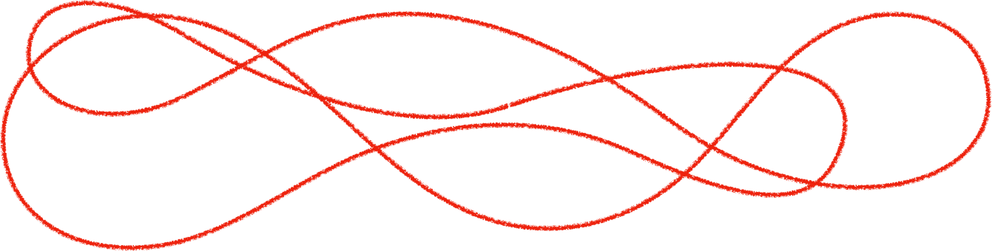

Slide 33


Slide 34


Slide 35
Governance…
…will always be messy.

Slide 48


Slide 50
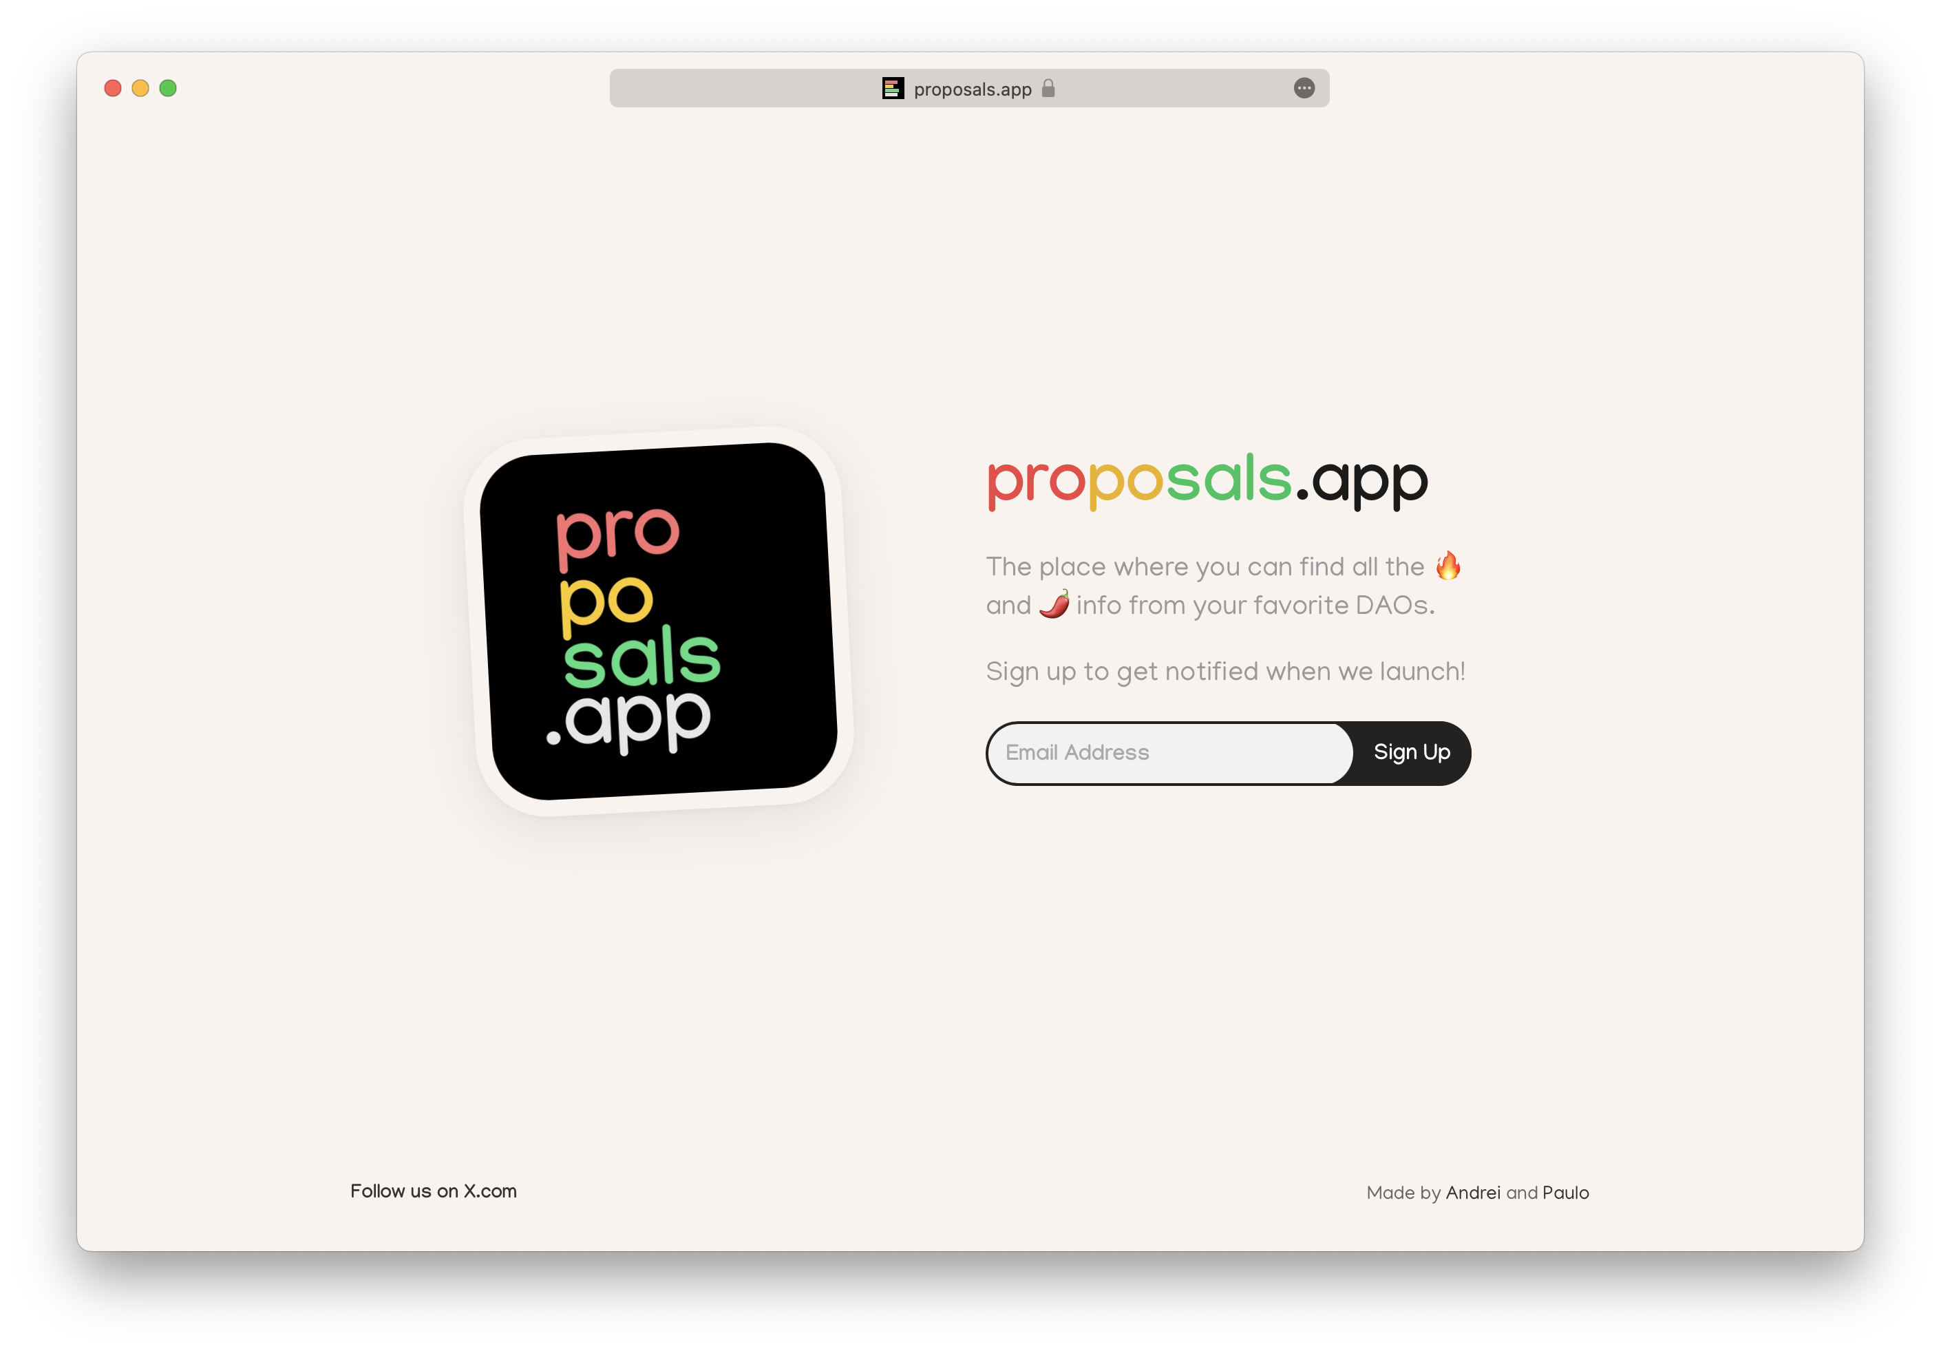

Slide 53



Slide 55
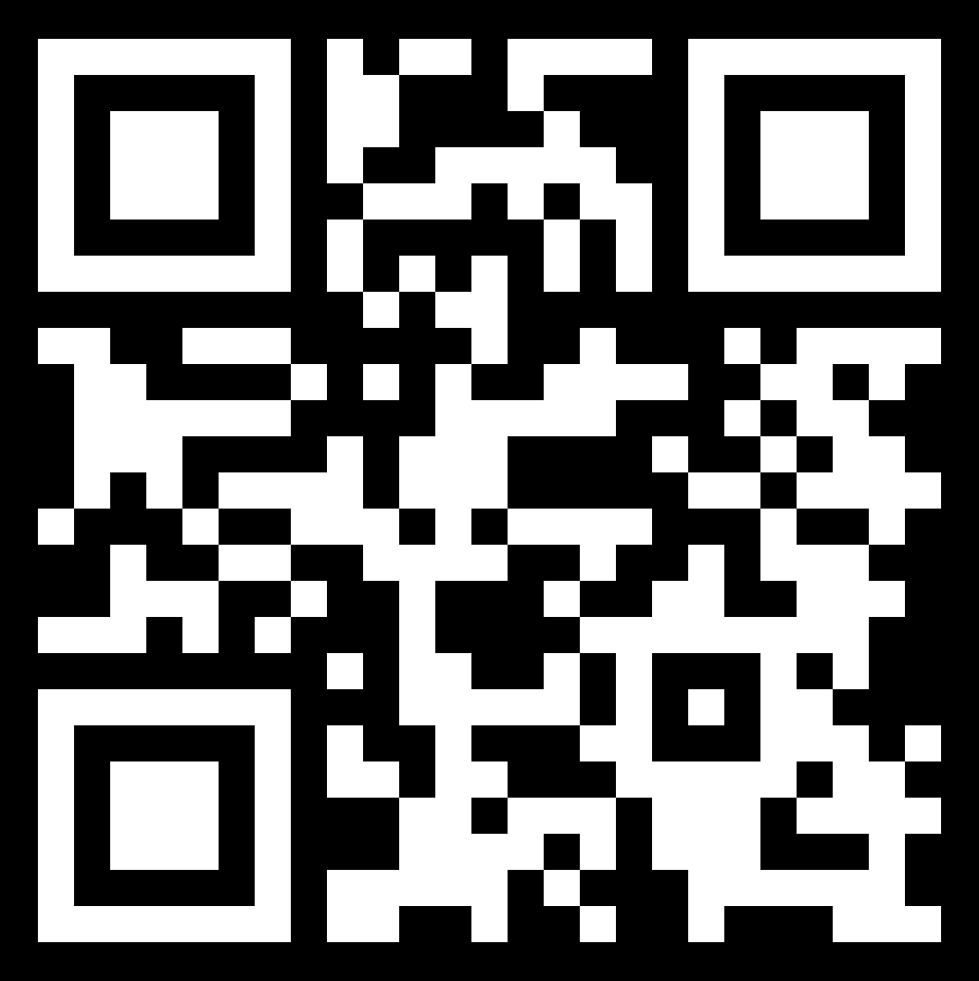
Thank you!
You can freely download, edit and reuse this presentation at:
bit.ly/governanceismessy

